Slide 1
Study Abroad Scholarship
Overview of scholarship funding sources

Slide 2
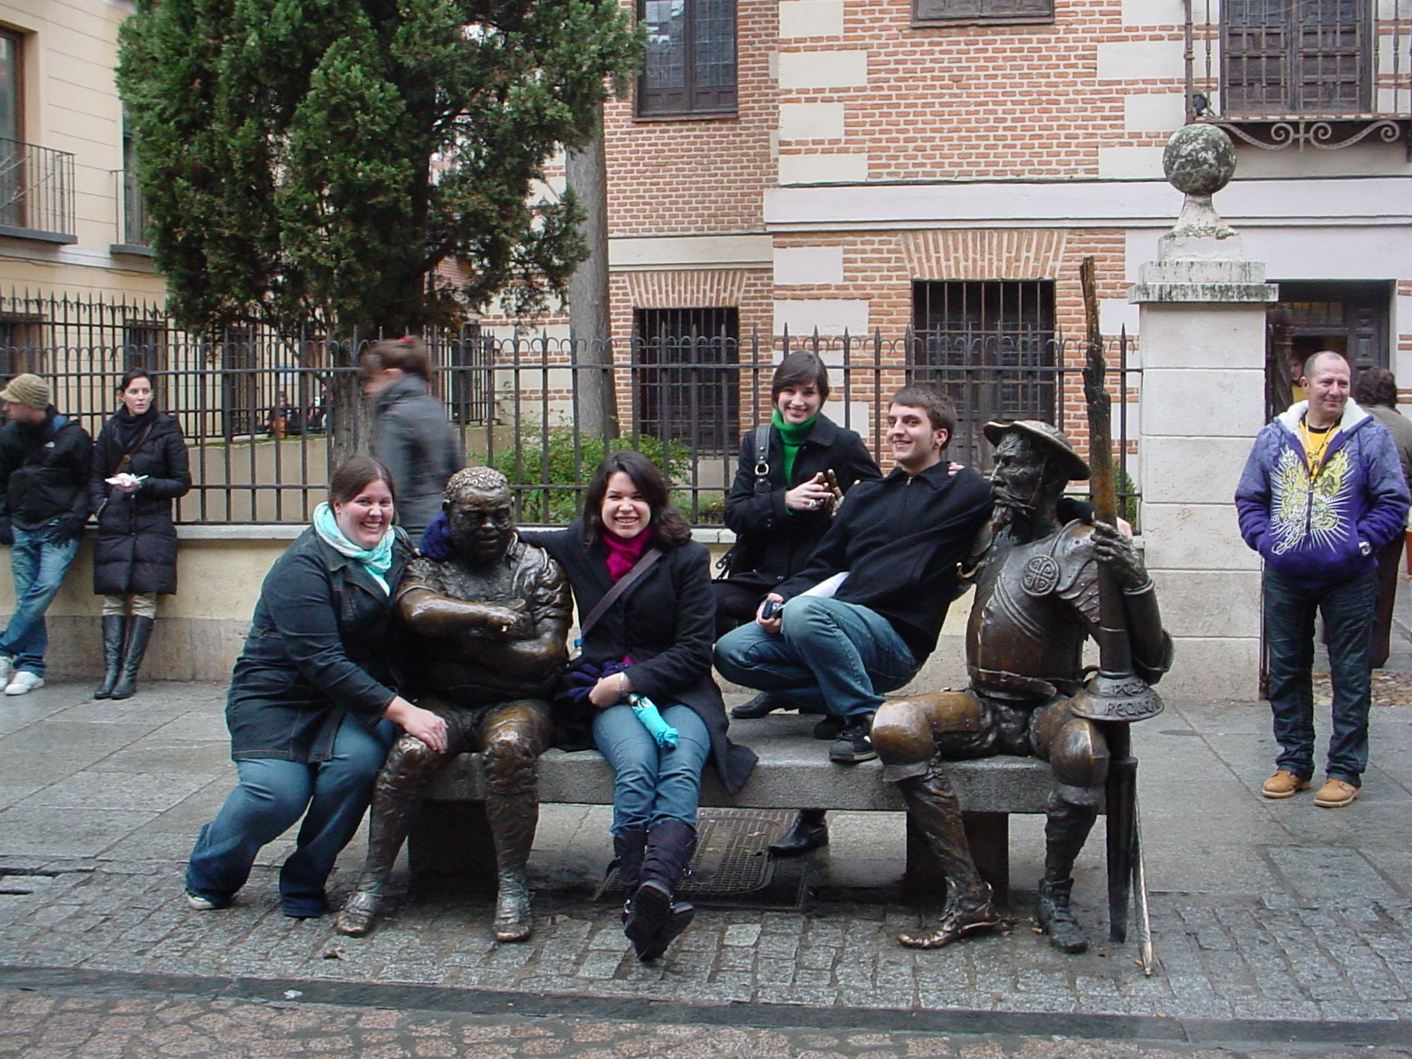
Types of funding sources
Stipends & Scholarships
External vs. Internal

Slide 3
Rider’s Stipends & Westminster’s scholarship
Stipends are disseminated the month prior to departure
Stipends are to off set the purchase of flights and up front housing costs, i.e. Housing deposits
The Crane Study Abroad Scholarship for Westminster students is needs based and for language programs only
Austria: Uni- Graz and KUG = $2,250 USD
Australia: USC = $800 (Approximate due to exchange rate)
France: ABS = $2500 USD
  CEFAM = $1500 USD
Spain: Alcala & Nebrija =
  $2,000 USD

Slide 4
U. S. Government Scholarships
GILMAN
GILMAN- Languages
Pell grant recipients
Minimum of 4 weeks in host country
Must be studying toward academic credit
Awards up to $5,000
Deadline: October 2nd
Pell grant recipients
Any destination with target language spoken
Critical Languages:
  Arabic, Chinese, Indic, Japanese, Korean, Russian and Turkic
  Awards up to $8,000

Slide 5
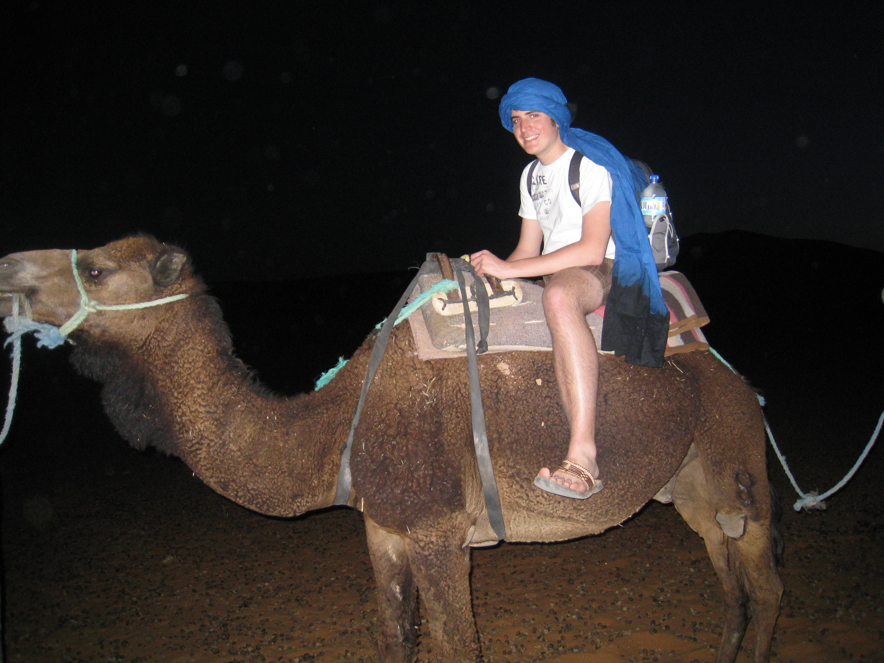
U. S. Government Scholarships
NESP BOREN Scholarships:
Must be at least 1 year of study abroad (unless STEM)
Must be to acquire a critical language
Goal is to be working with national defense
Student to submit essays, recommendations and personal statement to University Academic Council for review

Slide 6

Other Funding Sources
Diversity Network
Foundation for Global Scholars
Fund for Education Abroad
Phi Kappa Phi

Slide 7

IIE Passport
Lists varying external funding sources based on your criteria
Do your research for each of the organizations
Be organized and don’t miss a deadline!
http://www.studyabroadfunding.org/

Slide 8



Program Scholarships
Applying for funding from your program provider

Slide 9
Alliance for Global Education
Deadlines: October 15 for India programs / November 1 for China programs
Additional Funding for need based students if noted in application
Must be accepted into the program in order to receive the scholarship
http://www.allianceglobaled.org/finances/alliance-scholarships
Programs in China & India

Slide 10
API Scholarships
Scholarship Awards
Rider’s Programs
Italy: Diversity Scholarship with JCU
Merit based
Needs based
Must be accepted to their program before eligible to apply for scholarships
Rome, Italy
Budapest, Hungary
Krakow, Poland

Slide 11
CAPA Programs & Scholarships
Multiple scholarship and separate applications
Merit based = $500
Needs based = $2500
Access = $3000
Study Again = $600
London, England
Florence, Italy
Istanbul, Turkey
https://www.capa.org/

Slide 12

CIEE Scholarships
Rider’s Programs
Ghana
Russia
Scholarship site
Please note that for the Russia program- critical language applications are appropriate external funding sources

Slide 13

GlobaLinks Scholarships
Types of Scholarships
GlobaLinks Learning Abroad Affiliate University Scholarships University
Sponsored Scholarships Travel Grants
GlobaLinks Learning Abroad Student Scholarship
Diversity Scholarship

Slide 14

Interstudy
Rider’s Programs
Botswana
South Africa
Scholarship site

Slide 15
ISA Scholarships
Multiple program sites
ELAP opportunity
Internship opportunities
Specific applications for scholarship
http://studiesabroad.com/admissions/documents/scholarships/study/isa-scholarships

Slide 16

CIE Support
Essay review
Study Abroad confirmation with program providers or government agency
Boren applicants: arranges interview with Academic Council panel
Publicize your SUCCESS!

